Slide 1
Optimal Execution under Stochastic Volatility
By: Ben, Danielle, Milo, Nathan Hess, Nathan Hoendorf

Slide 2
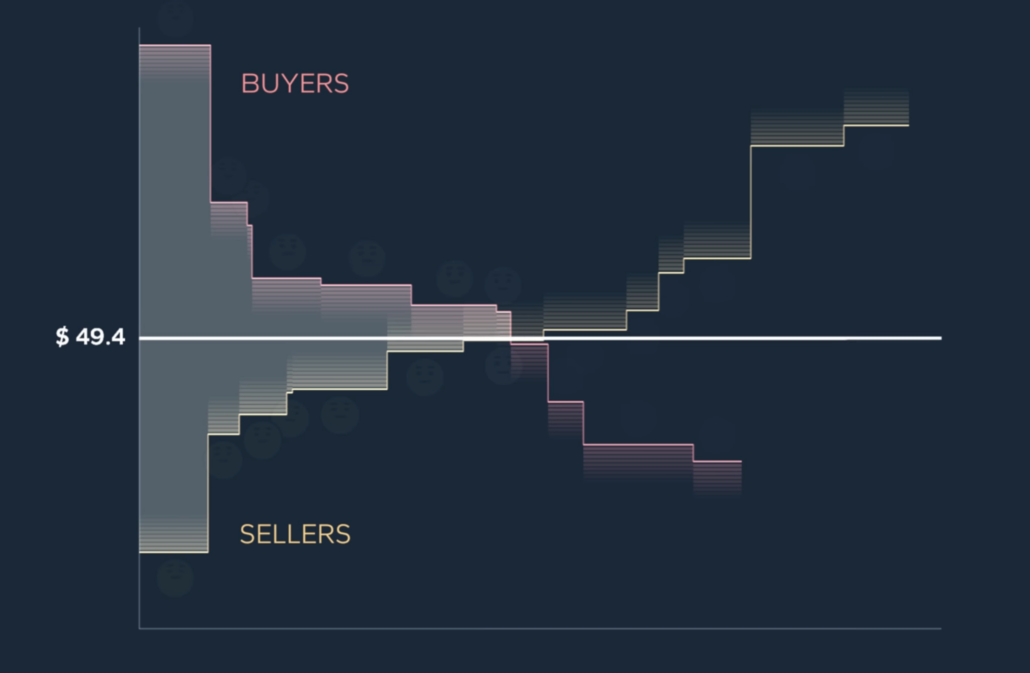
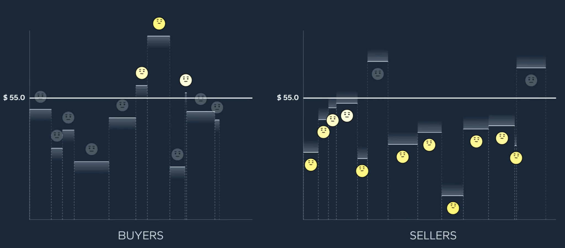
Stock market
Bid price: Highest price buyers willing to pay
Ask price: Lowest price sellers will accept
Bid-ask spread: Difference between ask and bid
Limited order book: List of buy and sell orders
Liquidity: volume available near current price
Volatility: how much price moves over time

Slide 3
The fundamental idea
Large trade incur two risks: Market impact, and Price Risk
Market impact: trading too quickly can move market against us
Market impact: Large orders consume liquidity
Price risk: Trading too slowly leaves too much exposure
Price risk: Higher volatility leads to more uncertainty in execution cost

Slide 4
Now for some math

Slide 5
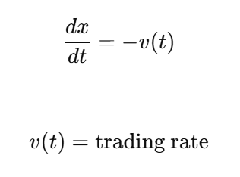

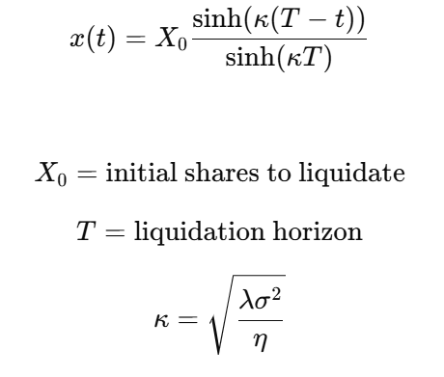
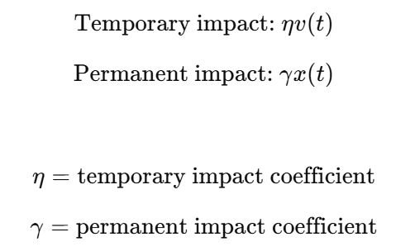

Almgren Chriss
Key Idea: Balance low market impact against low price risk
Inventory Dynamics
Market Impact Features
Optimal Trajectory
Notes:
Pick and choose your facts:
30,000+ Mines alumni
$95M in total research awards in fiscal year 2022
18 intercollegiate athletics teams
250+ student organizations on campus
An R1 “very high research activity” institution
$81,000 average starting salary for Colorado School of Mines graduates
1,300+ companies actively recruiting Mines students
Top 100 university, as ranked by U.S. News & World Report
Top 10 graduate programs in the country for Petroleum Engineering, Geophysics, Geology, as ranked by U.S. News & World Report
No. 1 best public universities by salary potential in Colorado, according to Payscale
152 Academic All-Americans – the most by any NCAA Division II institution
On average, 96% of graduates have positive outcomes, such as securing a job or advancing to graduate school
$44.5M raised by Mines in fiscal year 2022
$379.4M invested in the Mines endowment as of November 2022
250+ active research faculty at Mines
For the latest rankings, visit: https://www.mines.edu/rankings

Slide 6

More Almgren Chriss
Almgren Chriss assumes:
However in actuality volatility changes
Helped by the Heston model
Notes:
Pick and choose your facts:
30,000+ Mines alumni
$95M in total research awards in fiscal year 2022
18 intercollegiate athletics teams
250+ student organizations on campus
An R1 “very high research activity” institution
$81,000 average starting salary for Colorado School of Mines graduates
1,300+ companies actively recruiting Mines students
Top 100 university, as ranked by U.S. News & World Report
Top 10 graduate programs in the country for Petroleum Engineering, Geophysics, Geology, as ranked by U.S. News & World Report
No. 1 best public universities by salary potential in Colorado, according to Payscale
152 Academic All-Americans – the most by any NCAA Division II institution
On average, 96% of graduates have positive outcomes, such as securing a job or advancing to graduate school
$44.5M raised by Mines in fiscal year 2022
$379.4M invested in the Mines endowment as of November 2022
250+ active research faculty at Mines
For the latest rankings, visit: https://www.mines.edu/rankings

Slide 7



Stochastic Calculus and Ito
In regular calculus change is deterministic
Stochastic calculus has both a predictable and random element
Ito’s lemma solves being able to do the chain rule
Notes:
Pick and choose your facts:
30,000+ Mines alumni
$95M in total research awards in fiscal year 2022
18 intercollegiate athletics teams
250+ student organizations on campus
An R1 “very high research activity” institution
$81,000 average starting salary for Colorado School of Mines graduates
1,300+ companies actively recruiting Mines students
Top 100 university, as ranked by U.S. News & World Report
Top 10 graduate programs in the country for Petroleum Engineering, Geophysics, Geology, as ranked by U.S. News & World Report
No. 1 best public universities by salary potential in Colorado, according to Payscale
152 Academic All-Americans – the most by any NCAA Division II institution
On average, 96% of graduates have positive outcomes, such as securing a job or advancing to graduate school
$44.5M raised by Mines in fiscal year 2022
$379.4M invested in the Mines endowment as of November 2022
250+ active research faculty at Mines
For the latest rankings, visit: https://www.mines.edu/rankings

Slide 8
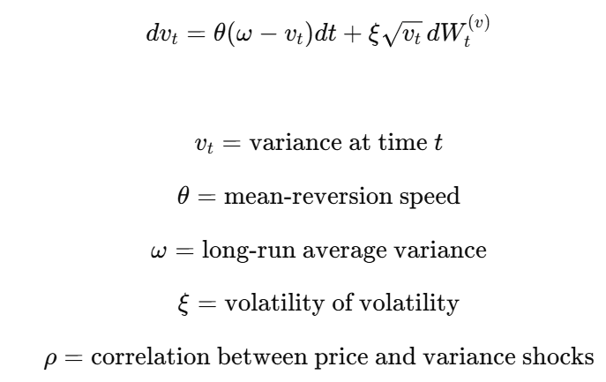
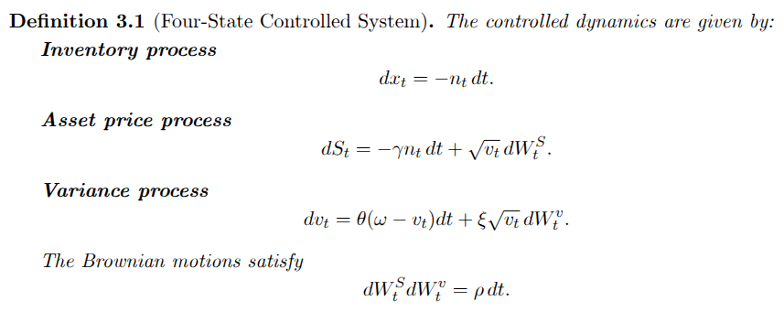
Heston
variance is now calculated so it is no longer constant
Says how volatility should shape AC Solution

Slide 9
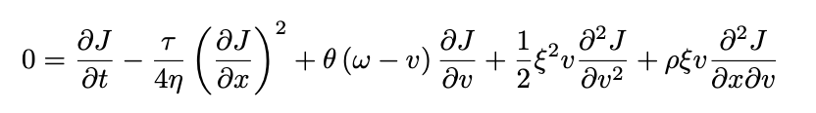
Hamilton–Jacobi–Bellman equation
A partial differential equation setup that assumes the most optimal route is being taken
Plugging in and combining Almgren Chriss and Hesston dynamics gives a “monster” PDE that is non-linear and cannot be solved easily

Slide 10
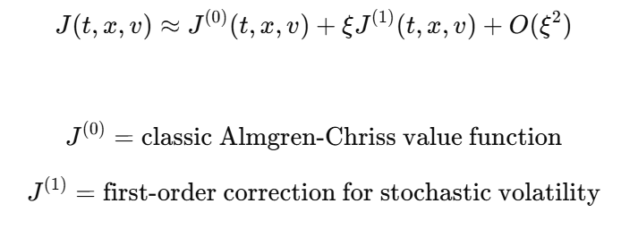
Use of perturbation
Assuming volatility of volatility is small allows us to perform a maclaurin expansion
Takin small perturbation around the volatility of volatility parameter
Used as an approximation due to equations complexity

Slide 11
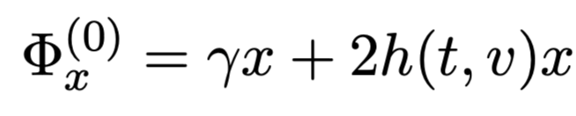
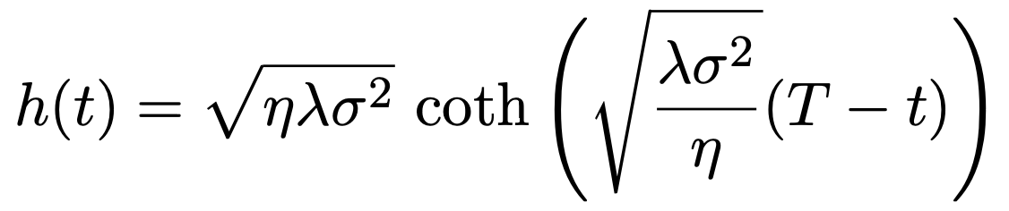
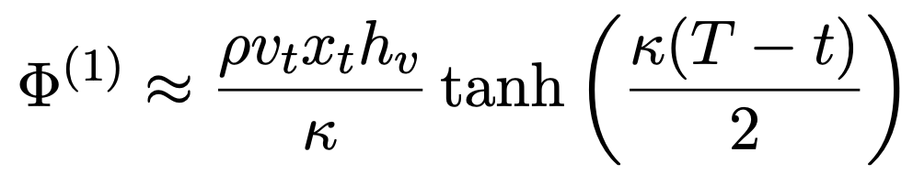
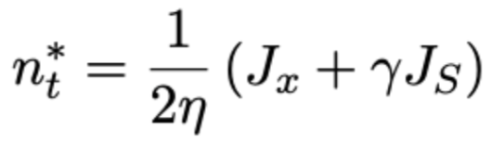
Solving Perturbation
Due to terms eventually differentiating out we can take out the needed terms
When constructing the HJB the equation for trading amount is already defined and now it can be plugged in again for the optimal trade

Slide 12

Volatility-Adjusted Trading Rate
Equation/Strategy combines AC schedule with dynamic stochastic correction
Rho greater than zero signifies rising risk, thus the correction must slow liquidation
Rho less than zero signifies appreciation, thus execution is sped up
Strongest correction is during middle horizon

Slide 13
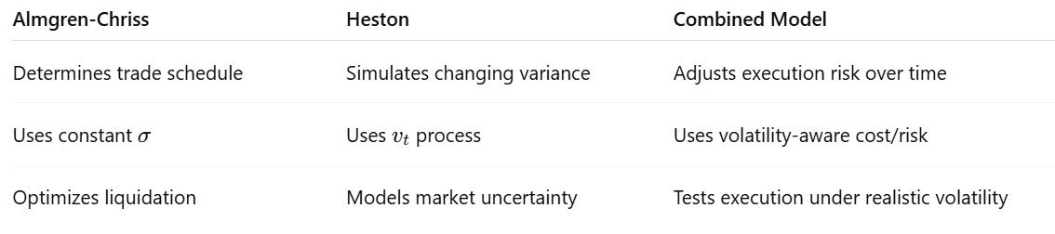
How they work together

Slide 14

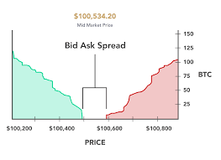
Data
We used the free lobster financial dataset
Data includes levels of bid and ask (up to 10)
These bid and ask orders are all all (up to level) that happened during the trading day
Free data: Apple, Amazon, Google, Intel, Microsoft

Slide 15



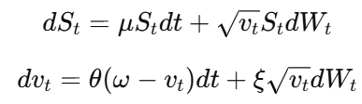
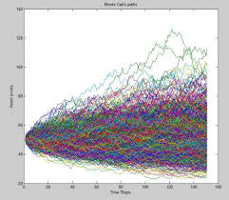
Computation & Data
Calibration of:
Calibration of heston:
Use 10,000 Monte Carlo paths for simulation
Calibrate based off given company

Slide 16
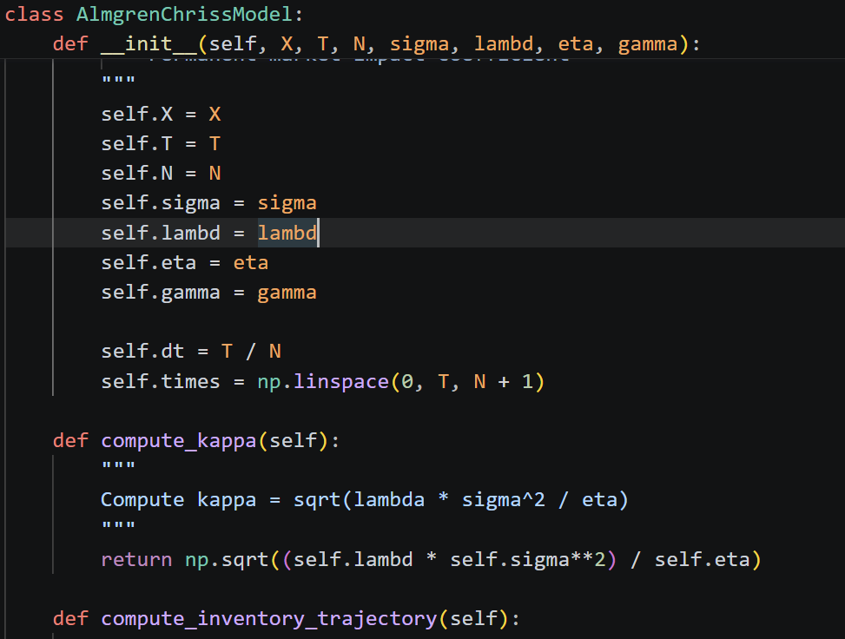
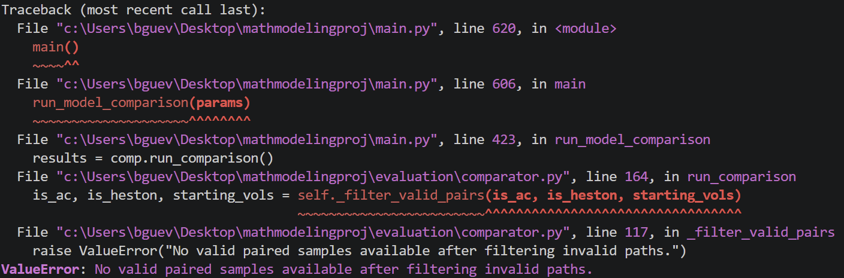
Code/Errors
Heston paths were sensitive to parameter choices.
Some simulated price paths became implausibly large.
Regime analysis failed when invalid paths removed too many paired samples.
Calibration for eta and was semi-stable.
Results should be interpreted as exploratory rather than final

Slide 17
Now for some analysis

Slide 18
Statistics
Paired t-test
t-statistic: -1.5880
p-value (one-sided): 0.9438
Reject H0: False
Wilcoxon Signed-Rank Test
p-value (one-sided): 0.9787
Reject H0: False
Indicates that the added complexity did not have a statistically significant cost advantage on average IS

Slide 19
Statistics
Implies that the Heston model does not perform statistically better when looking at overall market conditions
Across-dataset paired t-test
Valid datasets for mean test: 15
t-statistic: -1.1828
one-sided p-value: 0.8717
Heston has lower mean IS across datasets: False

Slide 20
Statistics
Regime Analysis
low-vol (vol ∈ [0.107, 0.190], n=3333)
Median diff=32660353.41521 p=0.0000 Reject H0: True
mid-vol (vol ∈ [0.190, 0.221], n=3333)
Median diff=-284291.67914 p=0.2141 Reject H0: False
high-vol (vol ∈ [0.221, 0.381], n=3333)
Median diff=-44922694.11317 p=1.0000 Reject H0: False

Slide 21
Statistics
Levene Variance Test
Statistic: 17124.0874
p-value (one-sided) : 1.0000
Reject H0: False
Two-Sample KS Test
KS statistic: 0.5071
p-value (two-sided): 0.0000
Reject H0: True
Indicates that the AC model performs safer
Indicates that they have statistically different results and are not interchangeable

Slide 22
Statistics
Implies that the Heston model performs much better in more stable markets
As volatility increases, the safer AC model takes less risks, reducing losses
--- Sharpe-like reliability comparison ---
Valid datasets for Sharpe test: 15
Mean Sharpe_AC: -46455.47665
Mean Sharpe_Hest: -2138.87188
t-statistic (Sharpe): 2.8762
one-sided p-value (Sharpe): 0.0061

Slide 23
Interpretation
The Heston model performs significantly better than AC in low-volatility environments
Heston model takes more risks and has a much higher variance
AC performs safer than Heston, so in high-volatility environments, it mitigates risk

Slide 24
Areas to continue
Our computation certainly had mistakes
Our ansatz need to be justified, and could be improved
Linear market impact is assumed to be linear, research shows it is usually root-2
Liquidity is assumed to be constant, meaning every transaction is locally equally equivalent
Our Limit Order Book Mechanics are simplified from real market microstructure
We assume variance evolves slowly over time, instead of Heston’s complicated conditional expectation

Slide 25
Thank you for listening!

